Slide 1
Super Shop sales Data analysis using power bi Dashboard
Author: Mr. Jay Jitesh Chavan

Slide 2
To contribute to the success of a business by utilizing data analysis techniques, specifically focusing on time series analysis, to provide valuable insights and accurate sales forecasting.
Objectives
Author: Mr. Jay Cavan

Slide 3
The objective can be broken down into the following detailed components: 1. Dashboard Creation: Identify the KPIs, design an intuitive and visually appealing dashboard, add interactive visualizations and filtering capabilities to allow users to explore the data at various levels of granularity. 2. Data Analysis: Provide valuable insights to business entities regarding the effectiveness of their sales strategies through visualization and charts.
DESCRIPTION
Author: Mr. Jay Cavan

Slide 4
3. Sales Forecasting: Leverage historic data and apply time series analysis to generate sales forecasts for next 15 days. 4.Actionable Insights and Recommendations: End goal is to share valuable insights and actionable information that can drive strategic decision-making and support the supermarket's goals for growth, efficiency, and customer satisfaction.
DESCRIPTION
Author: Mr. Jay Cavan

Slide 5
sTEPS of implementation:
IMPORTING DATA SET
DATA CLEANING
DATA PROCESSING
DAX QUERIES
ADVANCE DASHBOARD CREATION
FORECASTING

Slide 6
Output:
SUPER SHOP SALES DASDBOARD
2. SUPER SHOP SALES FORECASTING – 15 DAYS FORECAST

Slide 7
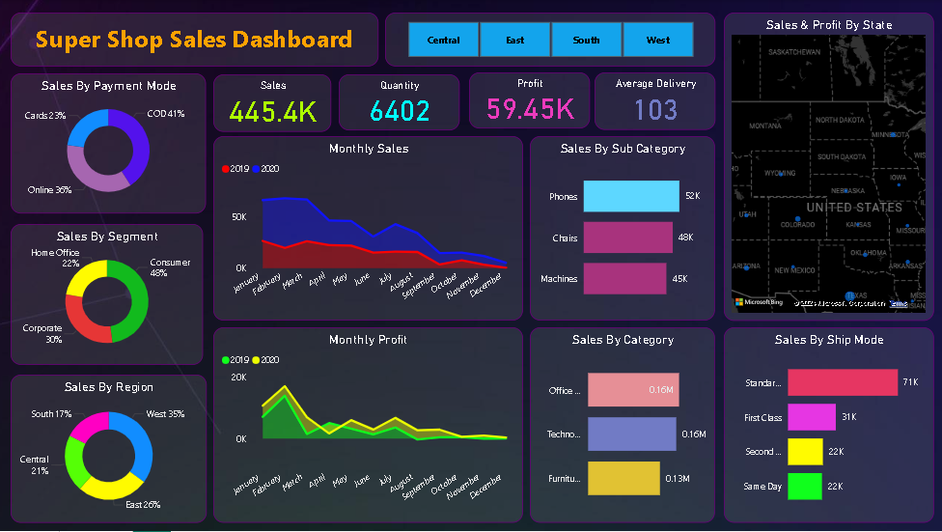

Slide 8
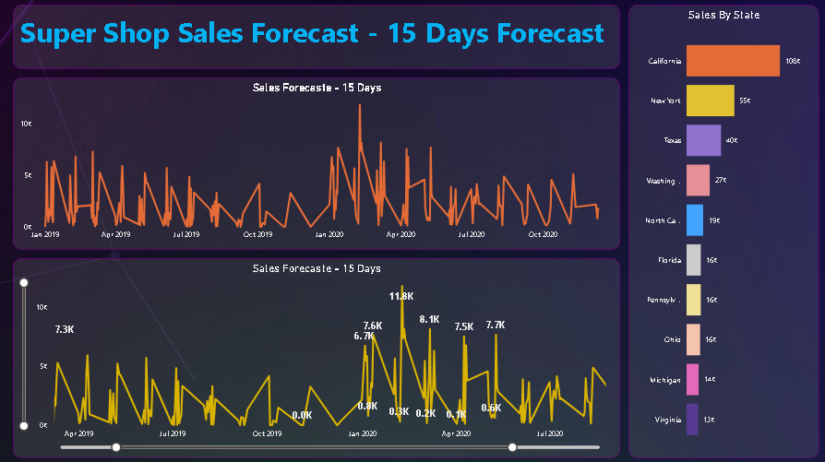

Slide 9
Thank You

